Slide 1


Slide 2
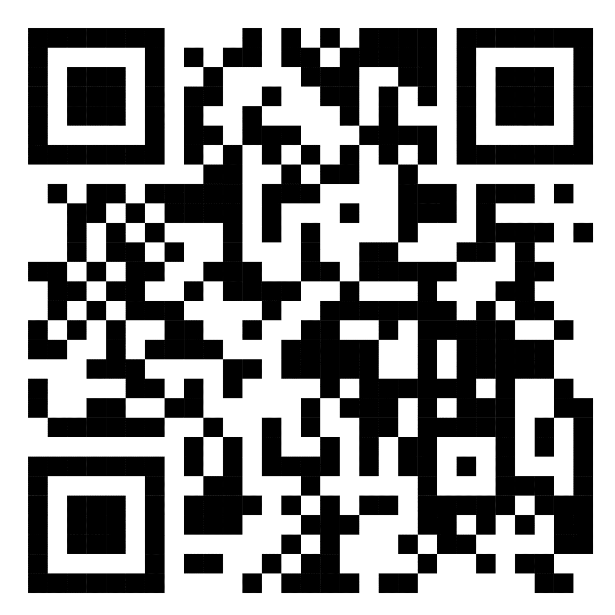
Scan & Register
DETAILS
Date & Time – 2nd Feb 2024 (10 :00 Am to 5:00 Pm)
Venue:- Block 30, Ground Floor, LPU Campus (Admission Area)

